Slide 1




“I’m not a grammar expert!”
Reducing Peer-Review Anxiety in a Business Writing Class
Amanda Goldrick-Jones | Student Learning Commons | Simon Fraser University
Shauna Jones (Co-investigator) | Beedie School of Business | SFU

Slide 2
Session approach . . .
Research question
About BUS 360W and this pilot project
Designing a regular, supported peer review process
Challenges: in theory and in practice
Assessing the pilot project
Next steps . . . and why we’re taking them
Notes:
The research project:
--is in its initial stages; results so far are based on one pilot semester
--falls under applied research, with the aim to enhance writing support for EAL students

Slide 3
Research Question . . .
Can appropriate training in peer-review--emphasizing higher-order issues and supporting second-order writing skills--raise the confidence of EAL writers as well as improve their writing fluency?
Notes:
Larger motives for trained, regular peer review:
help pre-professional students successfully negotiate the transition from classroom to professional discourse;
help EAL writers gain more abilities and confidence
Note: I differentiate team-based/collaborative writing from peer review, even though both are socially mediated and interrelated. This follows DiPardo and Freedman, “Peer Response Groups in the Writing Classroom: Theoretic Foundations and New Directions” (Review of Educational Research, Vol. 58, No. 2. (Summer, 1988), pp. 119-149) as well as more recent discussions of peer review such as Kastma- Breuch’s Virtual Peer Review: Teaching and Learning about Writing in Online Environments (2012).

Slide 4

While business communication texts generally cover collaborative or team-writing strategies (e.g. Locker et al., 2013; Alred et al, 2012; Bovée et al., 2011; Meyer, 2010), processes for effective peer review are rarely highlighted or singled out.
Notes:
PR not forefronted in large part because of negative perceptions about its quality, efficiency, and overall value. PR tends to be equated with editing for grammar or mechanics (Holst-Larkin, 2008; Rieber, 2010). This perception biases student and faculty attitudes about peer review (Vorobel & Kim, 2013; Ren & Hu, 2012) and militates against writers for whom English is an additional language.

Slide 5
About BUS 360W @ SFU
Multi-section writing-intensive course. 4 credits; up to 50 students per section with TA support.
writing strategies you can confidently adapt to a wide range of professional situations
guided writing practice in realistic business contexts
strategy, mechanics, and professional image
critical thinking and teamwork
Major writing assignments include 2 submissions of
email message / letter case study / persuasive team report

Slide 6
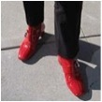
The “writing boot camp” pilot:
Jan. - Apr. 2014
PEER REVIEW to help students . . .
Prepare for collaboration at work —> move away from dependence on expert/supervisor (Popov-Doroshkin, 2012, p. 4).
Prepare to write for multiple audiences/stakeholders
Learn through teaching to build skills and confidence
Foster a sense of community
Periodic in-class WRITING SUPPORT (”SLC”) to . . .
Enhance peer-review and revision processes
Improve English fluency and quality; reduce anxiety

Slide 7
Designing a peer review process
Week 2:
In-class/online
orientation to
peer-review
strategies
(SLC*)
Students assigned a
“peer buddy” for each
half of term
Peer-reviewed
assigns:
Introductory profile
Email message
Letter case study
+
Peer-review buddy
evaluation
Peer-review RUBRIC
for each assignment: 1st
submission (8% grade)
Weeks 3 - 6:
In-class
“writing boot camps” in
response to issues (SLC*)
Peers revise based on reviews: 2nd submission
(12% grade)
*Created and delivered by the SFU Student Learning Commons in consultation with BUS 360W instructor

Slide 8
Creating a peer review environment
WEEK 2 IN-CLASS WORKSHOP on peer review
PURPOSE: “. . .help to break down pre-conceived ideas of working with native and non-native speakers . . . prepare students to work effectively in pairs to provide written and verbal peer feedback throughout the semester” (From the course instructor’s “boot camps” planning document.)
How to Give Effective Peer Feedback is available at Prezi.com

Slide 9
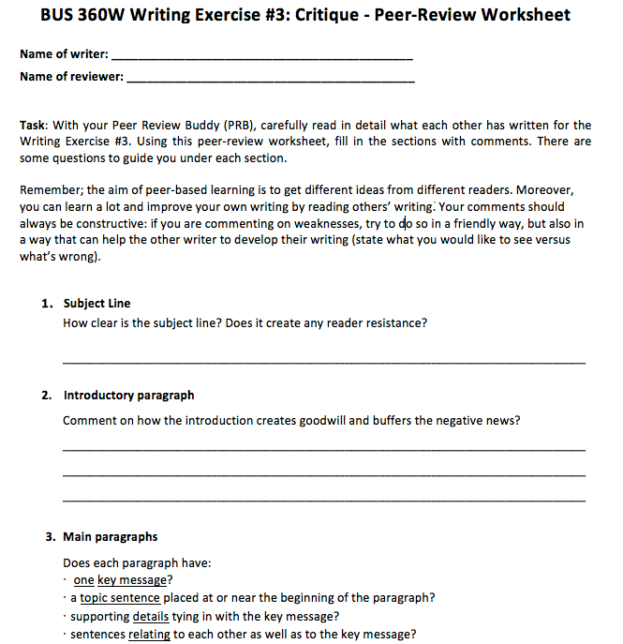
Peer-review RUBRIC
sample …closest to “checklist approach”
(Rieber, L.J., 2006)
Excerpt: from page 40-42 of Marshall, S. (2012). Academic writing: Making the transition. Toronto, Ontario, Canada: Pearson

Slide 10
Challenges to integrating peer review in BUS 360W
“CORPORATE CULTURE”:
Peer review has not been adopted broadly in business faculties (Rieber, 2010)
Yet students will “certainly use [this skill] in their future work lives” (Holst-Larkin, 2008, p. 76).
PRECONCEPTIONS:
Mere editing for grammar or mechanics (Holst-Larkin, 2008; Rieber, 2010)
“I don’t trust a peer’s writing ability” or “Only the prof/TA’s feedback counts.” (These are among “typical anxieties” described by Wisdom, 2006, p. 11)

Slide 11

What did we learn from this pilot? Some negative feedback
Challenges: peer feedback not as high in quality as teacher feedback / peers should be more equally matched in writing ability / writer’s mark might suffer if peer gives incorrect feedback / a peer might unethically borrow a writer’s
idea / the rubric is too restrictive /
Notes:
Issue re "mixed" EAL/non-EAL classes: value? challenges? attitudes? Difficult to generalize from primarily L1 or L2-based studies. As for students (or faculty) who privilege teacher authority, Hedy McGarrell (CWCA, May 23/14) has pointed out that research on L1 and L2 writing development is contradictory about the amount and helpfulness of teacher commentary.

Slide 12
Student concerns (around EAL issues) are corroborated . . .
From a study of peer review among Chinese ESL/EFL writers:
. . . whereas more than a third of the participants in the survey preferred to have teacher feedback only, no one preferred to have peer feedback alone. Furthermore, although 60.3% of the students preferred to have both teacher and peer feedback, qualitative analysis indicated that a great majority of them described teachers as experienced experts and teacher feedback as being authoritative and effective, whereas they found peer feedback useful only in addressing surface language corrections or offering an alternative perspective. (Ren & Hu, 2012, p. 4)

Slide 13
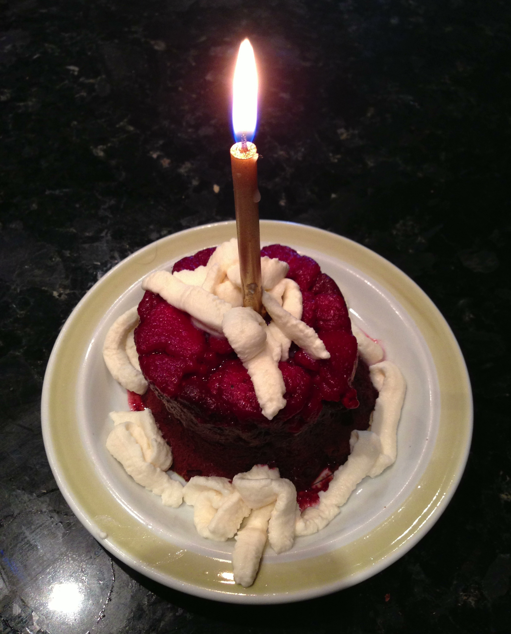
What did we learn from this pilot? Some positive feedback
Opportunities: gaining different perspectives / another pair of eyes to spot errors / promotes accountability / more incentive to meet deadlines / chance to help each other improve / rubric a source of useful guidelines

Slide 14
How can students benefit from peer review?
L1 context — [Written] peer review helps students develop "disciplinary knowledge or discourse skills in content-area courses" and find "a confident and authoritative voice and identity" (Schneider & Andre, 2007).
EAL (L2) context — ". . . recent research has reported positive correlations between a feedback provider’s feedback and the quality of their writing" (Althauser & Darnall, 2001; Cho & Cho, 2011; Li, Liu, & Steckelberg, 2010—cited in Choi, 2013).

Slide 15
How can students and instructors benefit from incorporating peer review?
". . . peer feedback combined with teacher feedback. . .beneficial for increasing L2 knowledge and lower L2 writing anxiety" (Choi, 2013). The effects of giving peer feedback on learning and revision may be greater than the effects of receiving feedback.
"Studies reveal that peer feedback activity encourages interactions in class and improves memory and academic achievement (Fantuzzo, Riggio, Connelly, & Dimeff, 1989; Fuchs, Fuchs, & Burish, 2000; Beirne-Smith, 1991—cited in Choi, 2013)

Slide 16
Another benefit . . .
“Although the peer review process takes time and involves organization and planning, it proves its worth at grading time” (Rieber, L.J., Using peer review to improve student writing in business courses, Journal of Education for Business 2006).
  The instructor reported that the 2 “pilot” BUS 360W classes had more grades than usual in the A-range.

Slide 17




From the IRP report . . .
“. . .the analysis suggests that students with access to peer review training and in-class writing support do, on average, achieve higher course grades, and that this relationship is statistically significant.”
Result: 0.255
increase in
average
course grade
0.33 separates two letter grades (e.g. B+ to A-)
Notes:
Prepared by Simon Fraser University’s Institutional Research & Planning office, May 2014.

Slide 18
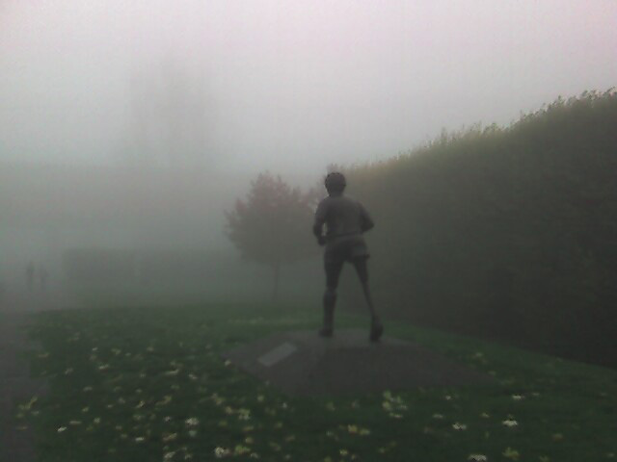
Next round: BUS 360 post-feedback
Provide more ways for L1 students to challenge themselves —> linking learning with providing peer support
Encourage peers to ask—“does this make sense?” rather than “is this correct”?
Move more bootcamp content online
Spend in-class bootcamp time on revising

Slide 19
Moving on—from pilot to project:
Next stage of research:
  student questionnaire (Questions 2 & 5 adapted from Diab, N. W. Effects of peer- versus self-editing on students’ revision of language errors in revised drafts.)
  TAs: survey and feedback on student writing
  analysis of student draft + PR + revision packages:
    attitudes —> Burkeian cluster criticism
    structural features —> instructor rubrics suggesting criteria; grounded theory (Babcock and Thonus, pp. 44 – 45). See PPT notes for further details.
Notes:
Students’ attitudes toward peer review will be derived from cluster criticism, a method of rhetorical analysis focusing on repeated uses of key, resonant terms and words/phrases frequently associated with those key terms. Determining which terms are “key” or “resonant” depends on the rhetorical situation or context, in this case formed by the assignment requirements and the writing topic. The resulting clusters of terms provide insights into a speaker or writer’s sense of identification with and attitudes toward a practice, group, or concept. In this case, identification would concern whether or to what extent students identify themselves as informed peer reviewers, and attitude would concern whether or to what extent they see peer review as a legitimate or valuable practice.
A detailed description of Kenneth Burke’s cluster criticism method for rhetorical analysis is available at http://amandagoldrickjones.files.wordpress.com/2012/01/clustercritappendix.pdf
Coding for analysis of written materials will be based on the instructor’s rubrics for guiding the peer review process; common grammatical and stylistic features in the drafts; and markers’ comments. This form of analysis relies on grounded theory, which allows the researcher to examine the data iteratively and to code the data based on reiterations or other significant features that rise to the surface.

Slide 20
Moving on—from project to praxis:
How can we help peers work through differences in language fluency?
What approaches could increase EAL students’ confidence (or decrease anxiety) in their writing?
How does peer review impact students’ revisions in specific ways?

Slide 21
References
Alred, G. J. et al. (2012). The business writer’s handbook, 10th ed. Boston & New York: Bedford/St. Martin’s.
Babcock, R.D. & Thonus, T. (2012.) Researching the writing center: towards an evidence-based practice. New York: Peter Lang.
Bovée, C. L. et al. (2012). Business communication essentials, 3rd Canadian ed. Toronto: Pearson Education.
Choi, J. (2013). Does peer feedback affect L2 writers’ L2 learning, composition skills, metacognitive knowledge, and L2 writing anxiety? English Teaching, 68: 3, 187-213.
Diab, N. M. (2010). Effects of peer- versus self-editing on students’ revision of language errors in revised drafts. System 38, 85–95, DOI:10.1016/j.system.2009.12.008
Holst-Larkin, J. (2008). Actively learning about readers: audience modelling in business writing. Business Communication Quarterly, 71:75, 75-80. DOI: 10.1177/1080569907312878
Locker, K. O. et al. (2013). Business communication: building critical skills, 5th Canadian ed. Toronto: McGraw-Hill Ryerson.
Meyer, C. (2010). Communicating for results: a Canadian student’s guide, 2nd ed. Don Mills: Oxford University Press.
Popov-Doroshkin, S. (2013). Becoming workplace ready: how small group tutorials can help. MA thesis, Department of English, California State University, Sacramento. Retrieved from http://csus-dspace.calstate.edu/handle/10211.9/2353
Ren, H. & Hu, G. (2012). Peer review and Chinese EFL/ESL student writers. English Australia Journal, 27:12, 3-16.
Rieber, L. J. (2010). Using peer review to improve student writing in business courses. Journal of Education for Business, 81:6, 322-326, DOI: 10.3200/JOEB.81.6.322-326
Schneider, B. & Andre, J. (2007). Developing authority in student writing through written peer critique in the disciplines. The Writing Instructor Beta 4.0 (Sept.), n.p. Retrieved from http://www.writinginstructor.com/schneider-andre
Vorobel, O. & Kim, D. (2013). Focusing on content: discourse in L2 peer review groups. TESOL Journal. DOI: 10.1002/tesj.126
Wisdom, S. W. (2006). Peer review in the contemporary corporation. Dissertation, Georgia State University. http://scholarworks.gsu.edu/english_diss/2

Slide 22
Comments, questions, & suggestions are welcome!
~~~~
Amanda Goldrick-Jones
Writing Services Coordinator
SFU Student Learning Commons agoldric@sfu.ca

